Slide 1
Titanic
2014038422 소프트웨어학부 하민수

Slide 2
Index
Kaggle
About Titanic
Data Description
Data Preprocessing
Training
  SVC, LR, RF, NN
Result

Slide 3
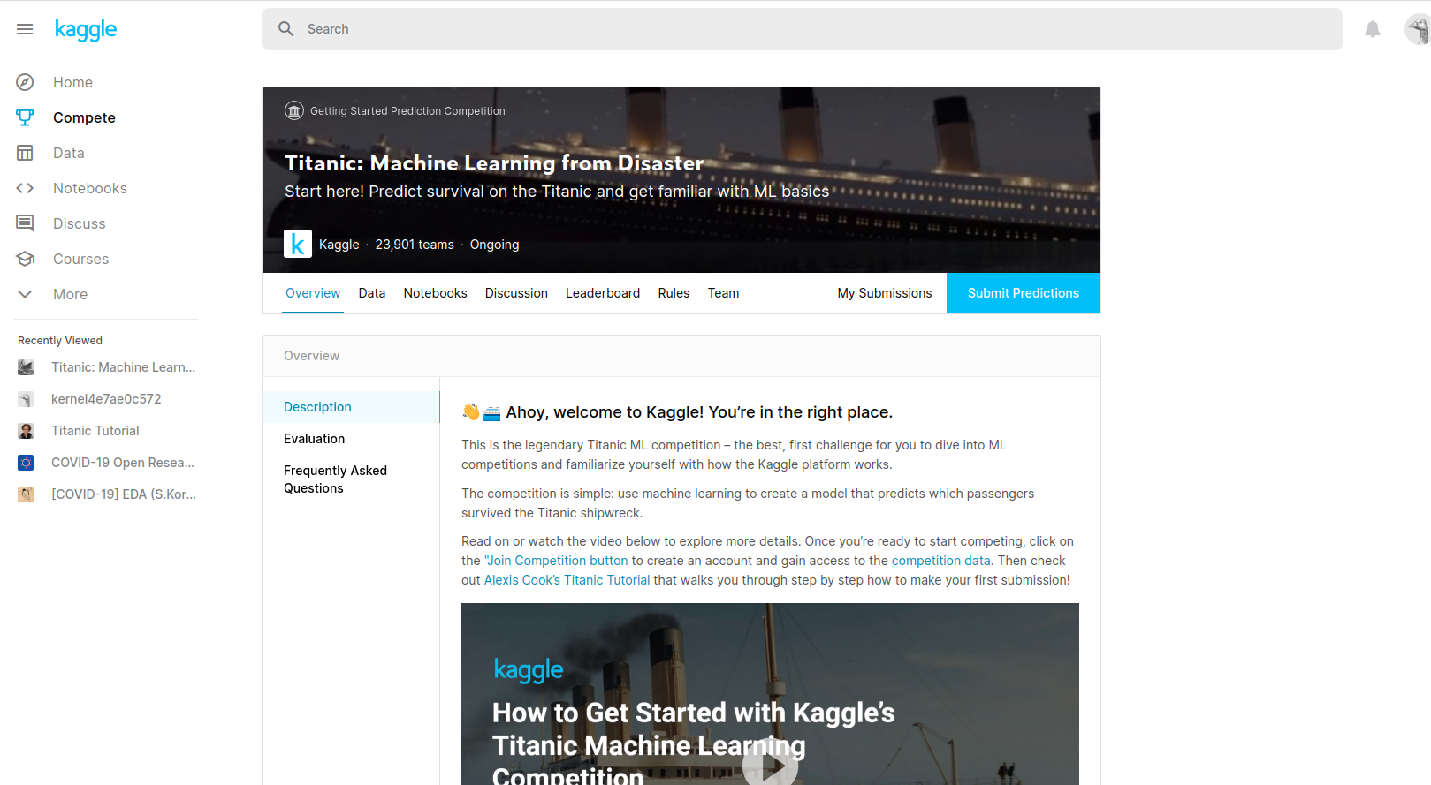
Kaggle
Titanic

Slide 4
About Titanic
(890, 12)
(419, 11)
test
train

Slide 5
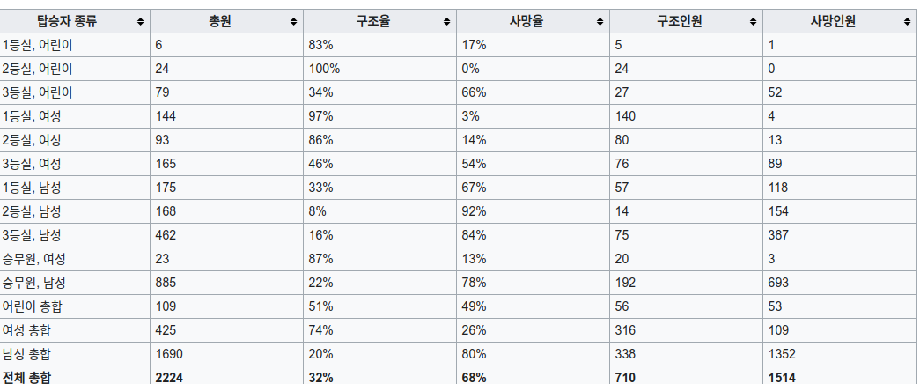
About Titanic
자료출처Wiki
성별
등급
생존과 밀접한 관련

Slide 6
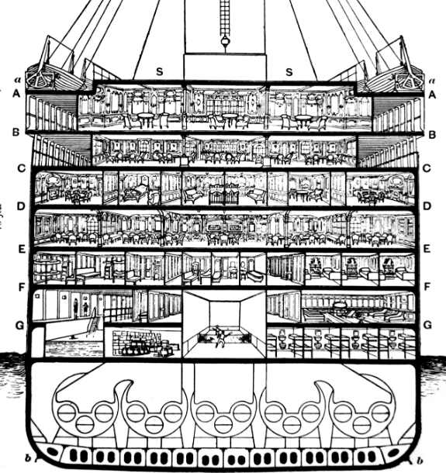
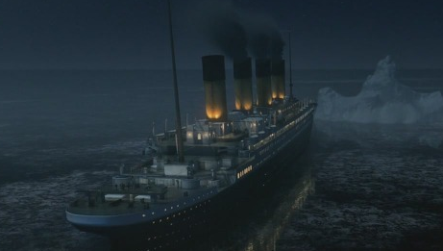
About Titanic
1st
2nd
3rd

Slide 7
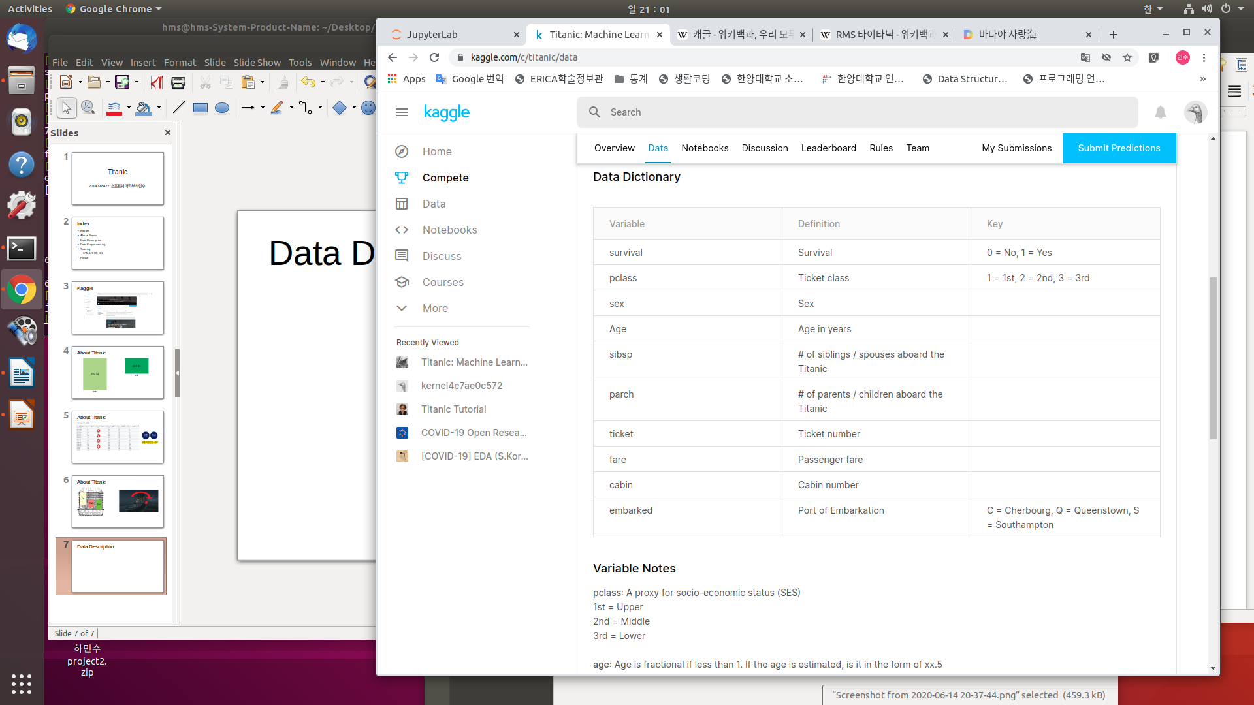
Data Description

